Slide 1
RMI IMPLEMENTATION IN PYTHON FOR DISTRIBUTED ENVIRONMENT WITH THE HELP OF THREE SYSTEMS

Slide 2
INTRODUCTION
We have implemented RMI for stock market price display scenerio.
We simply change IP address at server side all clients connect through server those are in same n/w.
We use server’s system IP address.
For terminate client side program we use “ctrl+c” (shown in client-2 result).

Slide 3
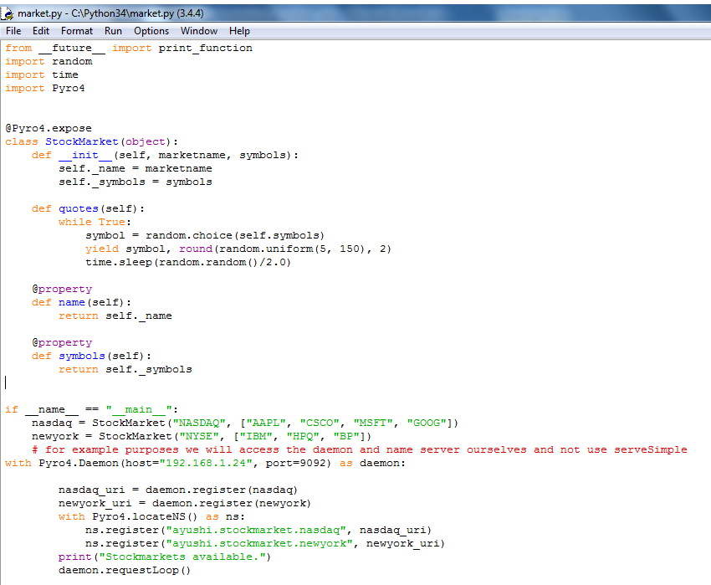
CODE-SERVER SIDE

Slide 4
CODE-CLIENT SIDE

Slide 5
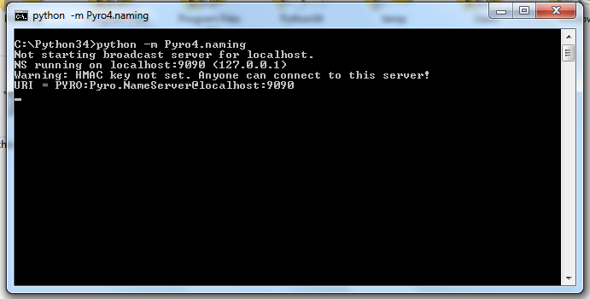
RESULTS-

Slide 6
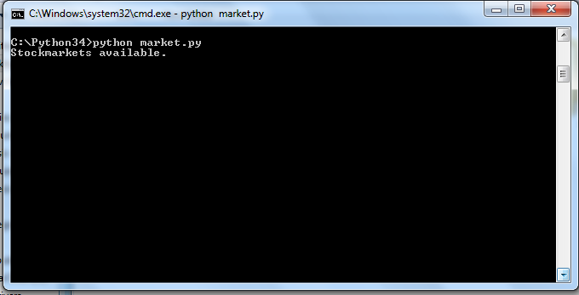
SERVER SIDE

Slide 7
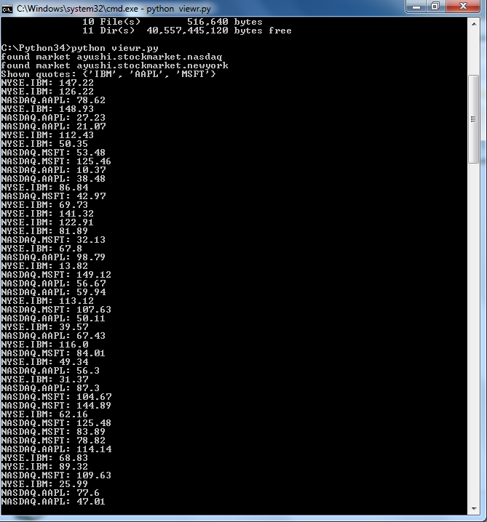
CLIENT SIDE-1

Slide 8
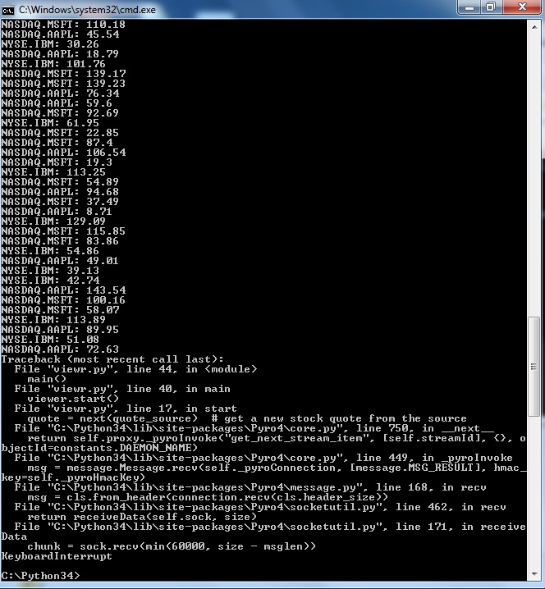
CLIENT SIDE-2

Slide 9
THANK YOU

